Slide 1
Fake news detection using nlp
Problem definition:
This research project aimed to develop a model using the techniques of NLP and ML to detect if a news article/headline is fake or not and identify which methods give better output. In this paper, we have presented six LSTM models and three different methods were used for feature extraction.

Slide 2
Designing thinking:
Design thinking is a problem-solving approach that emphasizes empathy, creativity, and collaboration to generate innovastage solutions. It typically involves the following stages:
Empathize:
Understand the problem by empathizing with the end-users or stakeholders. Conduct interviews, surveys, and observations to gain insights into their needs, challenges, and perspective.
Define:
Clearly define the problem statement based on the insights gathered in the empathy stage. Formulate a user-centered problem statement to guide the design process.

Slide 3
Ideate:
Brainstorm generate a wide range of ideas without judgment. Encourage creativity and free thinking. Techniques like brainstorming sessions, mind mapping, or worst possible idea can help in this stage.
Prototype:
Create tangible representations of your ideas. Prototypes can be sketches, wireframes, or even physical models. These prototypes are used to quickly test and iterate on ideas.
Test:
Test your prototypes with actual users or stakeholders to gather feedback. This step helps validate your ideas and identify areas for improvement.

Slide 4
Iterate:
Based on the feedback received in the testing phase, refine and iterate on your design. You may need to revisit previous stages to make necessary adjustments.
Implement:
Once you have a well-tested solution, move forward with implementation. This can involve developing the final product, service, or system.
Launch:
Introduce the solution to the target audience or market. Monitor its performance and gather real-world feedback.

Slide 5
Learn:
Continuously gather feedback and data from users and the environment. Use this information to make ongoing improvements to the solution.
Scale:
If the solution proves successful, consider scaling it up to reach a larger audience or market. Design thinking is a flexible and iterative process that can be applied to a wide range of challenges, from product design to organizational change. It encourages a human-centered approach, fosters creativity, and promotes a willingness to adapt and improve based on feedback and evolving insights.

Slide 6
1.Data Source:
Kaggle: Kaggle often hosts fake news detection datasets. You can search for relevant datasets on their platform.
Fake News Challenge: The Fake News Challenge was an initiative to develop tools for identifying fake news. They released datasets that can be useful for your project.
Fact-Checking Organizations: Fact-checking websites like Snopes, PolitiFact, and FactCheck.org provide datasets related to fact-checked articles. These datasets often include labels indicating whether an article is true, false, or somewhere in between. News Aggregator APIs: Some news aggregators, like News API or GDELT, provide APIs to access news articles from various sources. You can collect articles and then label them manually or use external sources for labeling.

Slide 7
Twitter Data: Twitter provides APIs to access tweets. You can collect tweets related to news articles and their URLs, then use fact-checking data to label them.
Research Institutions: Check if research institutions or universities have released datasets related to fake news detection. They often publish datasets used in academic research.
Crowdsourced Datasets: Some projects have collected fake news datasets through crowd contributions. These datasets may be available for research purposes.
Social Media Platforms: Platforms like Facebook and Reddit have released datasets related to misinformation and fake news. These can be valuable for training and testing your model. Remember to carefully review the terms of use and licensing agreements for any dataset you use. Also, consider combining datasets from multiple sources to create a more diverse and comprehensive dataset for training your fake news detection model. Preprocessing and cleaning of the data may be necessary to ensure consistency and quality.

Slide 8
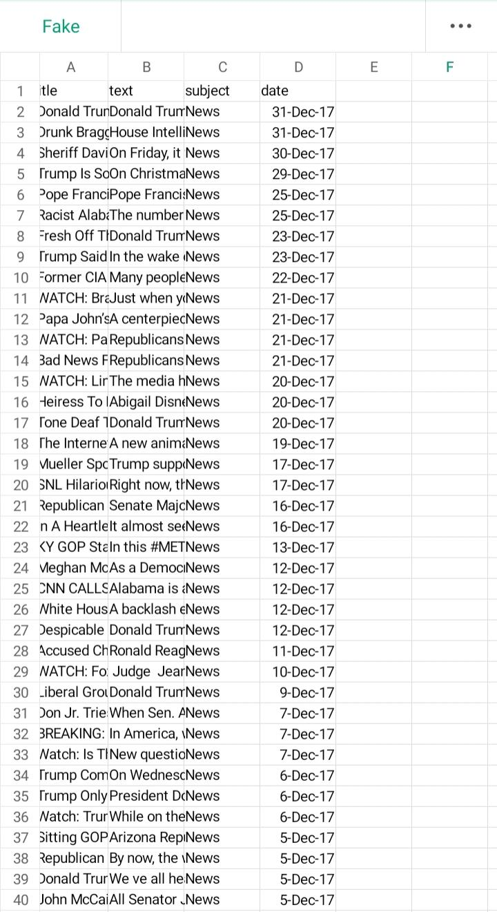
Fake dataset:

Slide 9
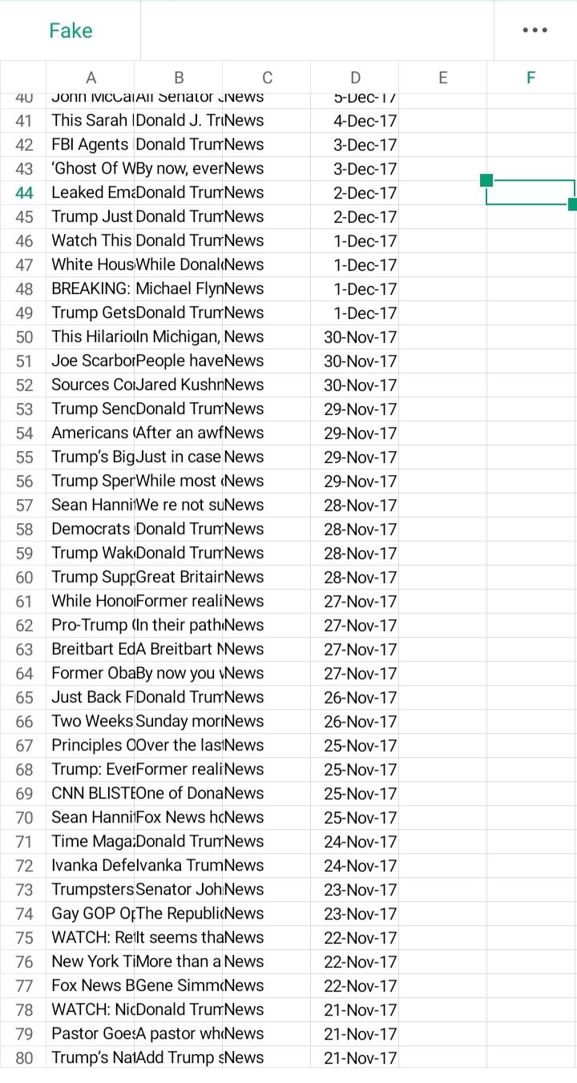

Slide 10
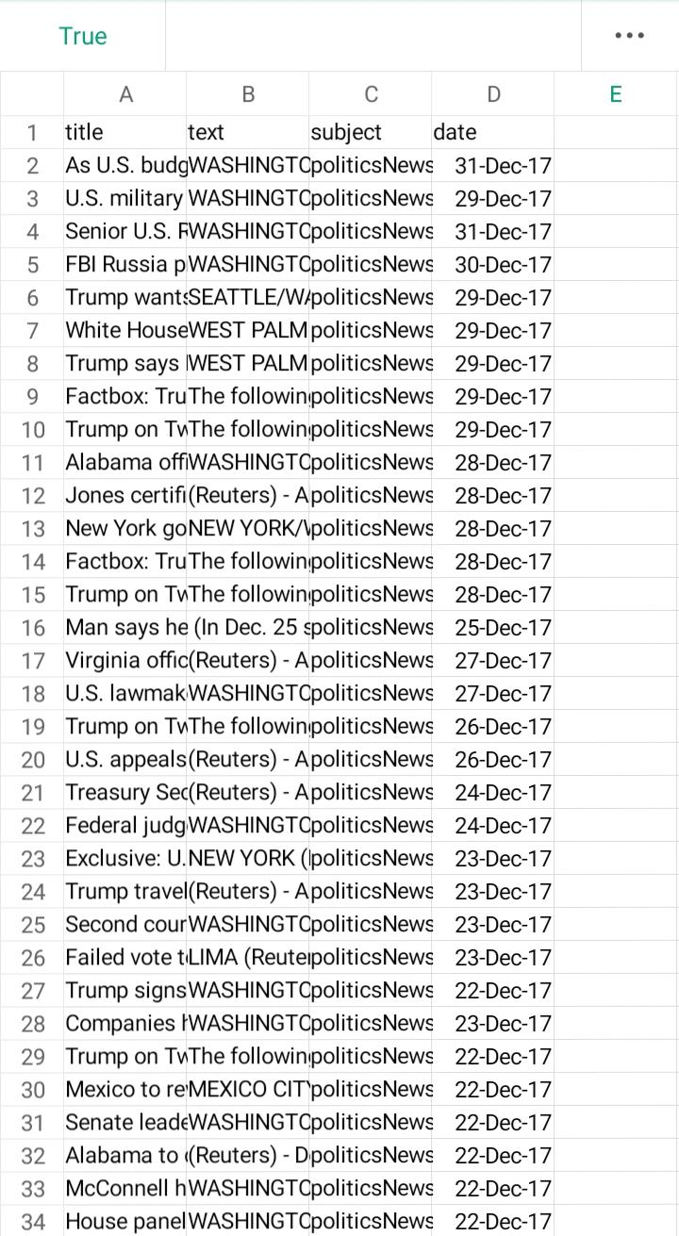
True dataset:

Slide 11
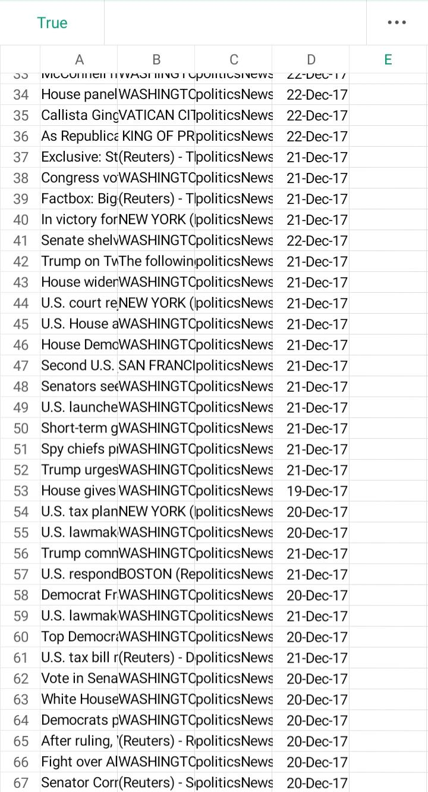

Slide 12
2:Data Prepocessing:
Clean and preprocess the text data by removing stopwords, punctuation, and performing tokenization and stemming/lemmatization.
3:Feature Extraction:
Convert the text into numerical features using techniques like TF-IDF (Term Frequency-Inverse Document Frequency) or word embeddings like Word2Vec or GloVe.
4:Model selection:
Choose a machine learning model for classification. Common choices include Logistic Regression, Naive Bayes, Random Forest, or deep learning models like LSTM or BERT.

Slide 13
Traditional Machine Learning Models:
Logistic Regression:
A simple yet effective model for binary classification tasks like fake news detection. Naive Bayes:
Particularly useful for text classification tasks and works well with text data. Random Forest:
Ensemble methods like Random Forest can capture complex patterns in text data.

Slide 14
Deep Learning Models: Recurrent Neural Networks (RNNs):
Long Short-Term Memory (LSTM) and Gated Recurrent Unit (GRU) networks can capture sequential information in text. Convolutional Neural Networks (CNNs):
CNNs can extract meaningful features from the text data and are often used for text classification tasks. Transformer Models:
Models like BERT, GPT, and RoBERTa have shown remarkable performance in various NLP tasks, including fake news detection. Fine-tuning pre-trained transformer models can yield impressive results. Ensemble Models: Combining multiple models, such as a combination of traditional ML models and deep learning models, can improve accuracy and robustness.

Slide 15
Rule-Based Systems: Create rule-based systems that look for specific patterns, keywords, or linguistic features commonly associated with fake news. Hybrid Approaches: Combine the strengths of traditional ML and deep learning models, as well as rule-based systems, to create a hybrid approach that leverages the advantages of each. Active Learning: Incorporate active learning techniques to iteratively improve your model by selecting the most informative samples for labeling. Explainable AI (XAI): Consider using models that provide interpretability and explainability, as understanding why a model makes a particular prediction is crucial for trust in fake news detection systems.

Slide 16
5. Model Training:
Train the selected model on your labeled dataset, using a portion for training and a separate portion for validation.
6.Evaluation:
Evaluate the model’s performance using metrics like accuracy, precision, recall, and F1-score. Cross-validation can help ensure the model’s robustness.

